Slide 1

WWW.PREDICSENSE.COM
Lets Begin designing the web!

Slide 2


LOGO
HOME PAGE
MENU OPTIONS
TAB 1
EMAIL ADDRESS
PHYSICAL ADDRESS
ABOUT US
CONTACT NUMBER
ALTERNATE NUMBER
TAB 2

Slide 3

TAB 1 FUNCTION
TAB 1
On clicking on this tab the user will be directed to the
Second new page

Slide 4
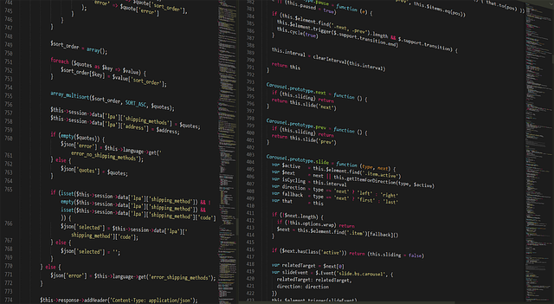

Second page
Questions e.g – What is your first pet name ?
By clicking on this
The question will
Change.
Answer box
This questions will continue as per the back end team interest.
The categorisation will complete during registration.
After answering all the questions the user will be directed to the third page.

Slide 5



Third page
Demo Timer
Will not be highlighted or active until and unless
A demo session is completed.
The demo session will be for 24 hrs for 1st visiting users.

Slide 6
Third page
Enrolment
(After 24 hours)

Slide 7
Fourth page
This page will be displayed to the registered/enrolled and logged in users.
The back end team will be in full flow with operations.

Slide 8



After this page regarding
Enrolment the user will
Be directed to the payment page
Fifth Page
Enrollment relating questions

Slide 9

PAYMENT PAGE
MONTHLY XXXXX/- PROCEED
QUARTERLY XXXXX/- PROCEED
ANNUAL XXXXX/- PROCEED

Slide 10
Lets go back to the home page

Slide 11
LOGO
HOME PAGE
MENU OPTIONS
TAB 1
EMAIL ADDRESS
PHYSICAL ADDRESS
ABOUT US
CONTACT NUMBER
ALTERNATE NUMBER
TAB 2

Slide 12
TAB 2 FUNCTION
TAB 2
On clicking on this tab the user will be directed to the
new page

Slide 13


Tab 2 second page
This page will have some predefined
Questions regarding
Application.
We will receive the user information
And will intimate as soon as possible
Finish

Slide 14
WWW.PREDICSENSE.COM
That’s all!!
Thank you very much!

